Slide 1
Final Presentation (Team)
By: Adrian Pulido (50%) and Zachary Cain (50%)

Slide 2
Feasibility Analysis
Operational feasibility- The app will be very simple regarding accessibility. It will have a basic design with different categories to ensure everyone will be able to easily learn how to use it.
Technical feasibility- Tech resources will not be a problem since we will be sure to have a highly skilled tech team working to design and develop the app. Once implemented, we can use iPads or tablets for employees to update the information when necessary.
Economic feasibility- $60,000-$80,000 is a very low cost to potentially end a drastic problem during a global pandemic. Once the app proves effective and the smaller, local hospital we will expand it to larger hospitals and it will all go towards to fight to stop the spread of Covid and lower cases.
Schedule feasibility- Time to develop a simple but effective app that everyone will be able to learn that can also do everything we plan will be about 2 months. That is not long enough to cancel our plans and we will be able to continue tracking PPE usage until the app is developed.

Slide 3
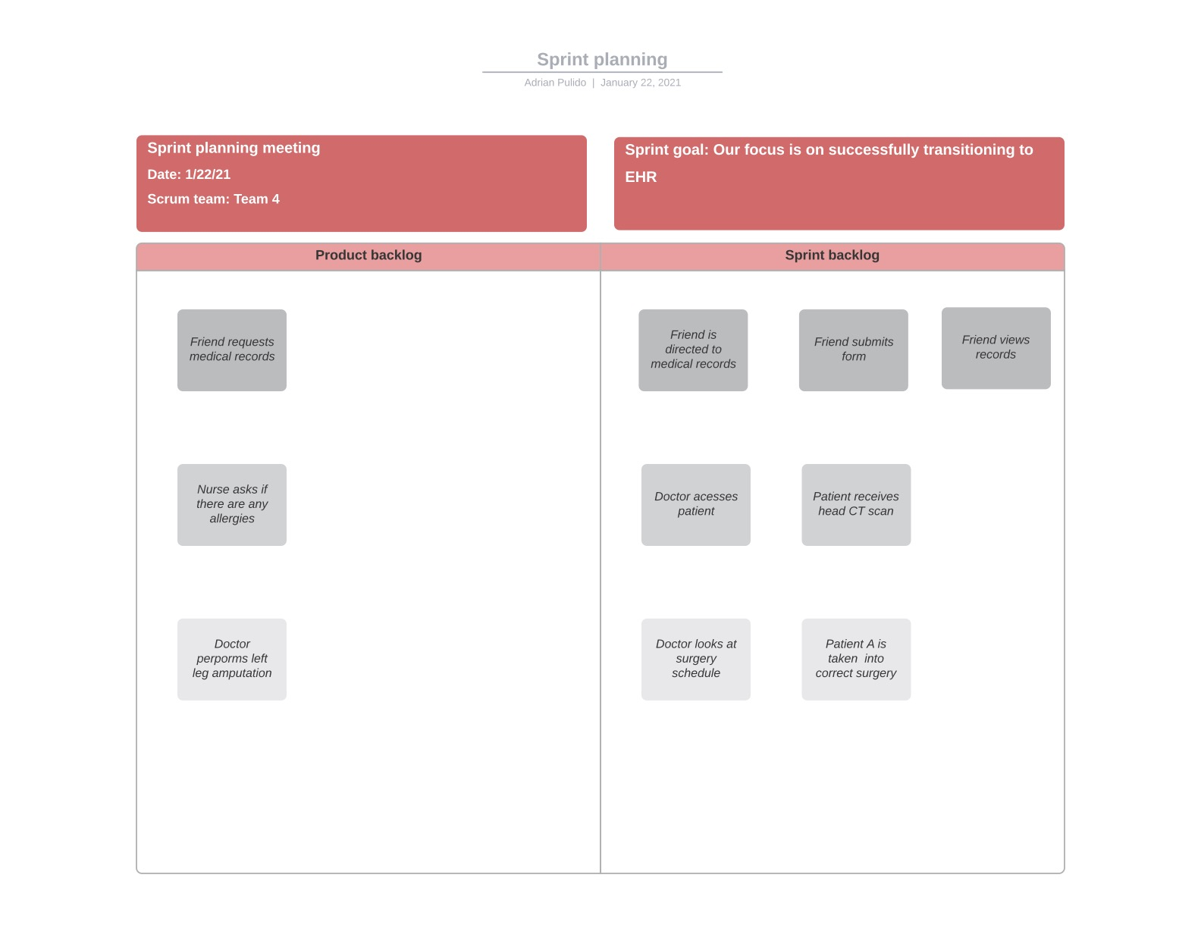
Project Plan

Slide 4
Requirements Models
Systems Requirements Checklist
Input Requirements (what do you plan to enter/input/come into your system)-1) Healthcare employees must swipe their ID cards. 2) Online data collection terminals will record labor costs and calculate production efficiency. 3) The department head must enter overtime hours on a separate screen in a healthcare provider’s office.
Output Requirements (what do you want to output/produce/results from your system)-1) The website must report online volume statistics every four hours and hourly during peak periods in a provider’s office. 2) The inventory system must produce a daily report showing the description of a patients’ health information. 3) In EHR, functional requirements must be in place for patients to access their records.
Process Requirements (what specific task(s), work, or user story(ies), does your system accomplish)- 1) Storing clinical information and data in an electronic format that can be retrieved and viewed efficiently via health information and data. 2) The ability to manage test results will be accomplished by result management. 3) Electronic processing of orders and prescriptions will be accomplished by order management.
Control Requirements (what types of security or control should your system provide)- 1) Security Management would provide policies and procedure for protecting assets. 2) Operational Security would identify critical information if friendly actions can be observed by enemy intelligence. 3) Physical Security Controls would provide deterrent, detective, and preventive measures that are meant to mitigate physical security issues for EHR.

Slide 5
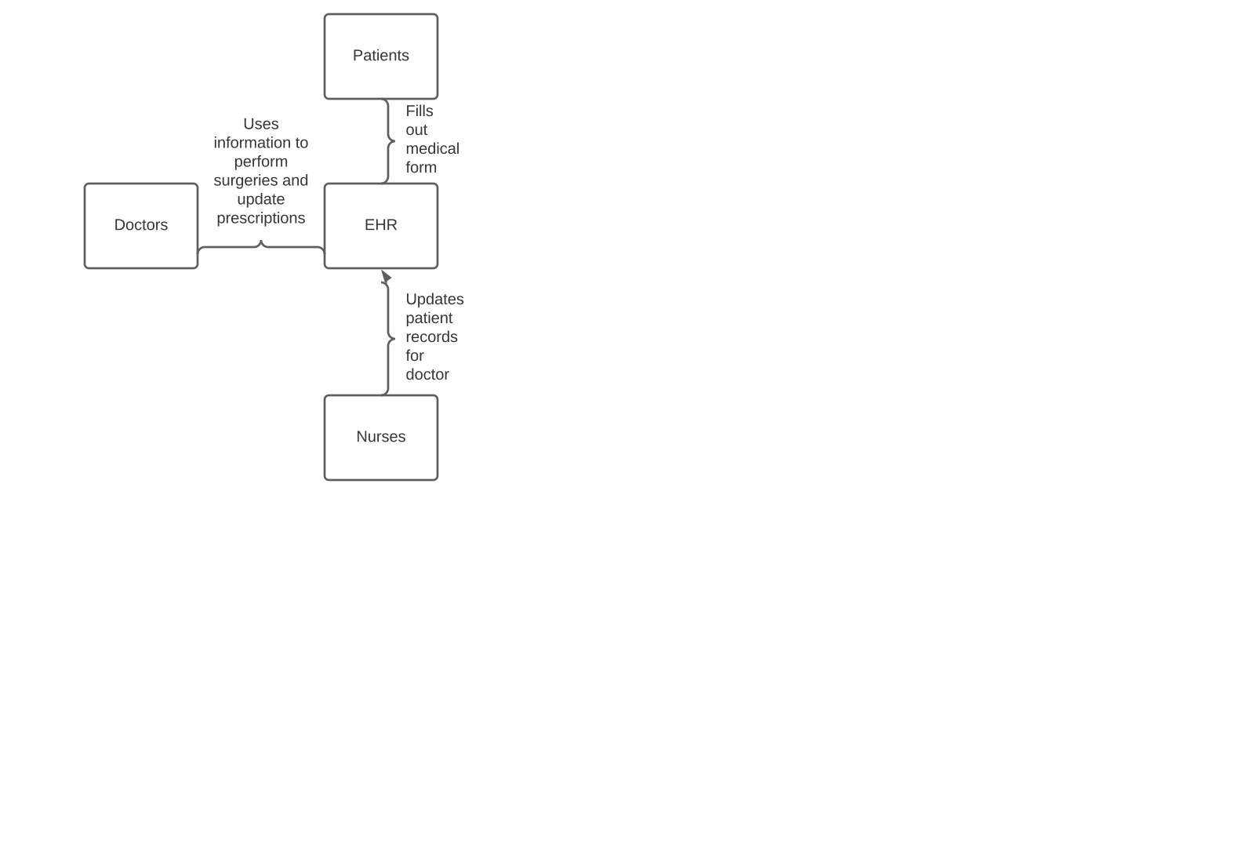
Data Flow Diagram (Context Diagram)

Slide 6
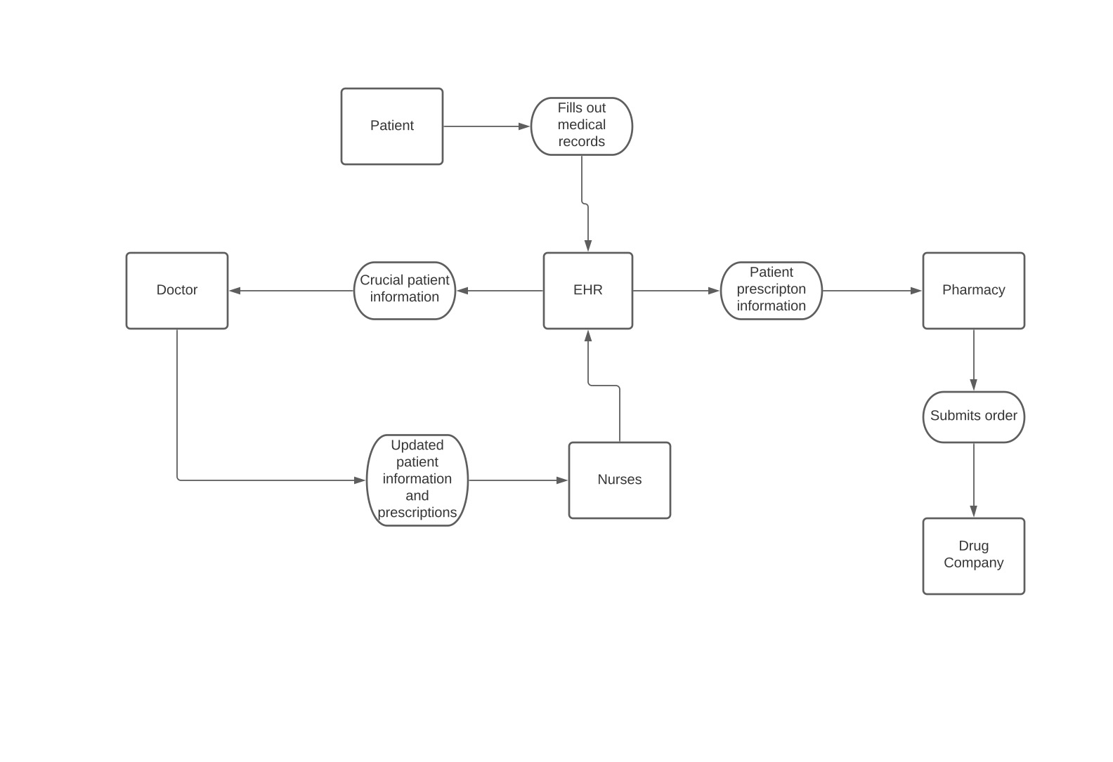
Data Flow Diagram (Diagram 0)

Slide 7
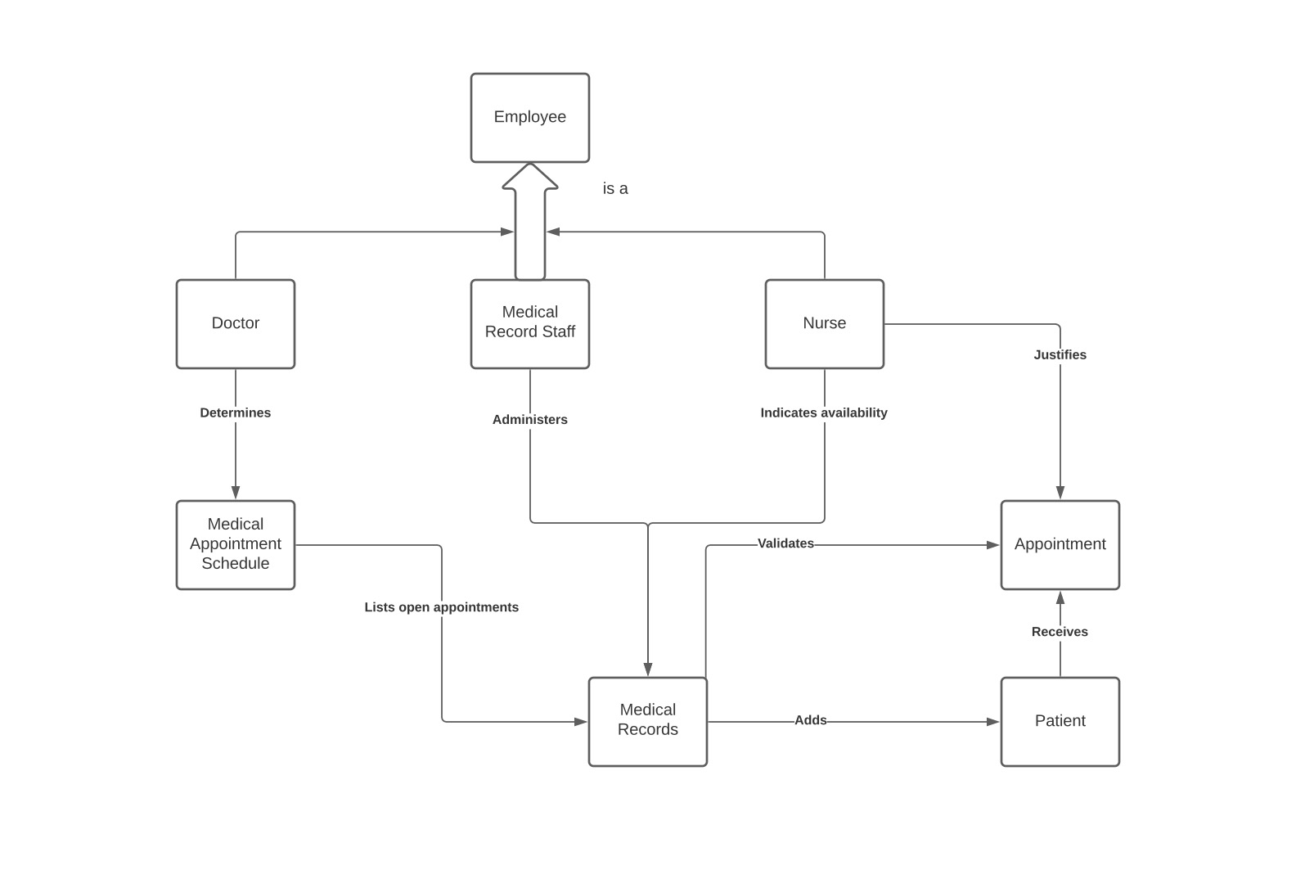
UML/Object Models (Object Relationship Diagram)

Slide 8
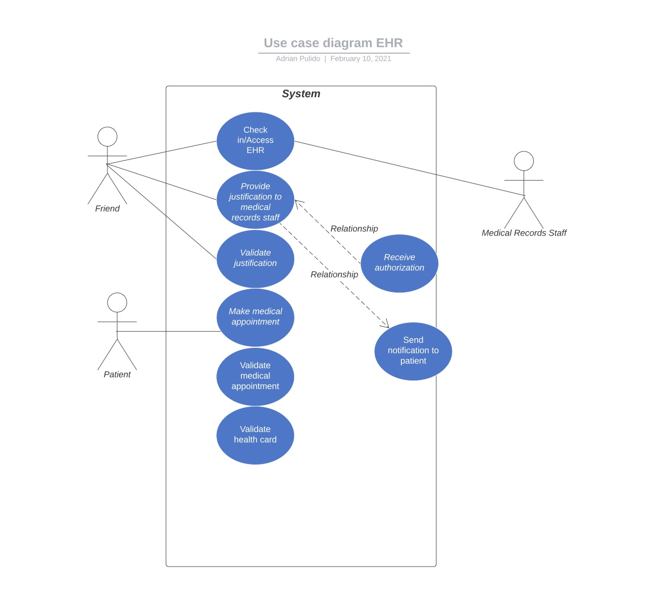
UML/Object Models (Use Case Diagram)

Slide 9
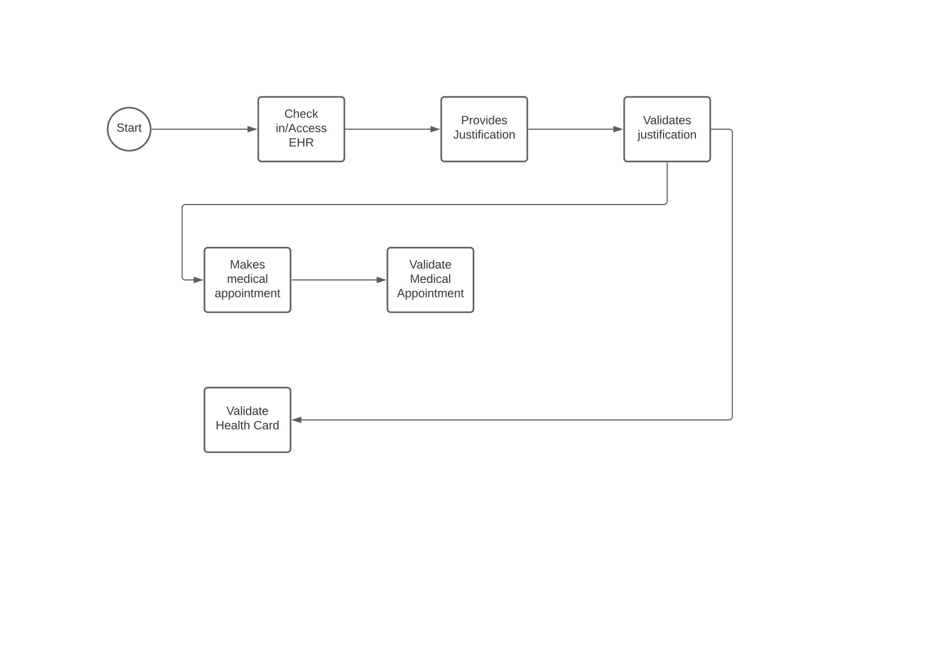
UML/Object Model (Activity Diagram)

Slide 10
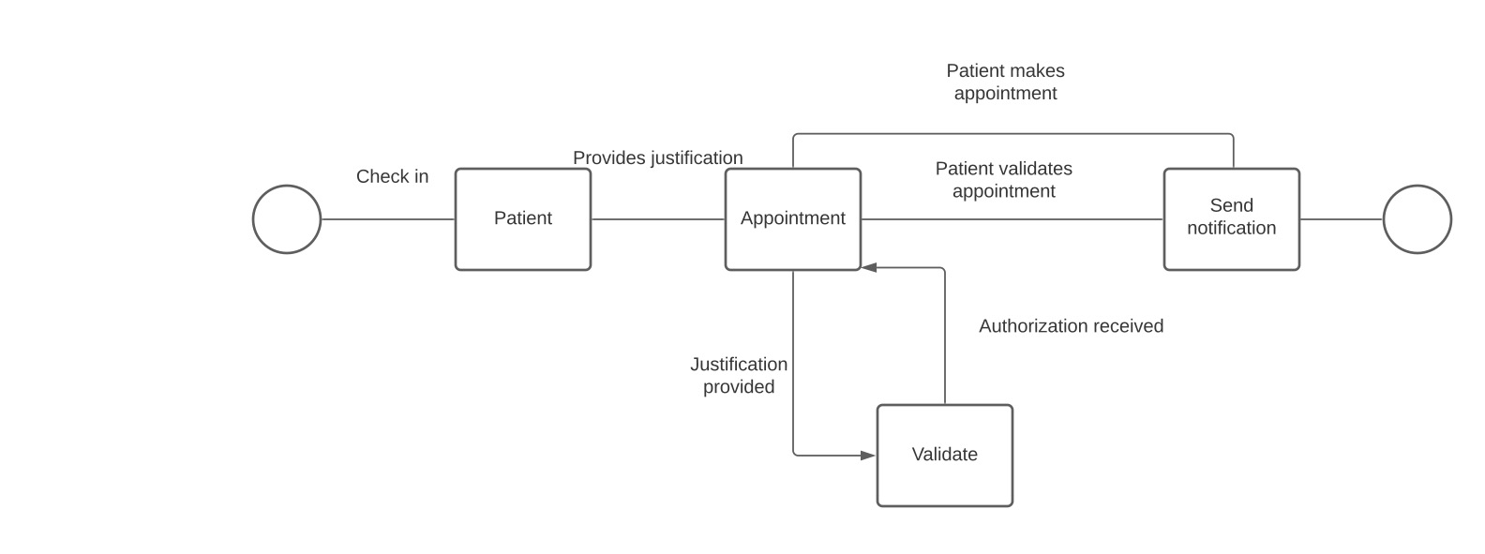
UML/Object Models (State Transition Diagram)

Slide 11
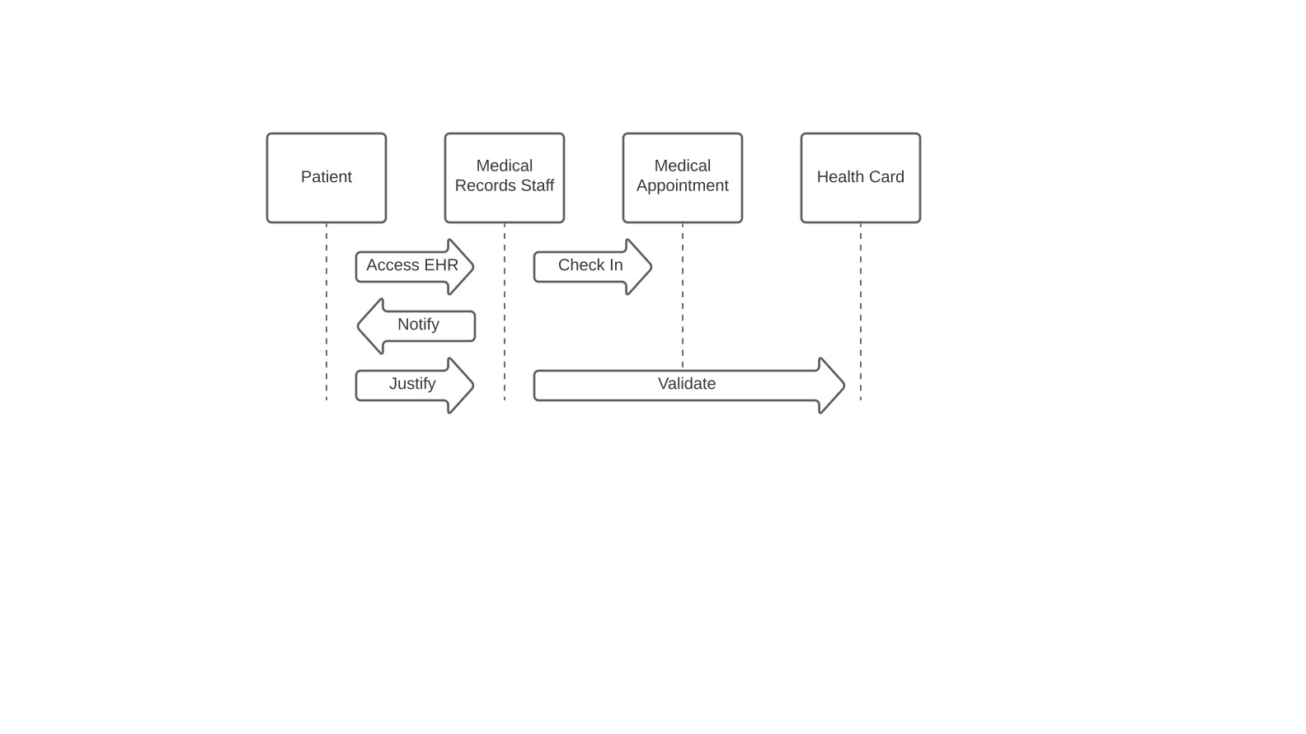
UML/Object Models (Sequence Diagram)

